Slide 1
BUSINESS LAW
Phd Andreea Stanciulescu

Slide 2
2
The application of law in time, space and and regarding persons, types of interpretation of rules.

Slide 3
QUIZ
The division of law that regulates the relations between the governments of two different states is:
International public law
National private law
National public law
International private law

Slide 4
Quiz
The division of law that regulates the relations between people under the jurisdiction of different states who have goods or interests in different states is:
A. national public law
B. international public law
C. international private law
D. national private law

Slide 5
Legal Rule. Definition. Scope
The legal rule is a constitutive element of the law, it is a rule imposed or recognized by the state.
Its scope is to guide the members of the society towards a behavior developed in accordance with the values established in the respective society

Slide 6
Legal Rule. Features
1. It has a general character - applies to all persons indicated in its hypothesis
2. It has an impersonal character - does not apply to a specific person, but to all provided in the hypothesis, without any distinction
3. It has a standardisation role - pursues the fulfilment of a certain uniformization of the behavior, codification of human action
4. It has a bilateral character - exchange between the persons in a permanent relation
5. It is mandatory - necessity to impose a social order

Slide 7
Structure of Legal Rule
Each legal rule has an internal structure
named the formal-logical structure and an external structure called the technical-juridical structure.

Slide 8
The formal - logical structure of a legal rule
the hypothesis
part of a legal rule that describes the circumstances when a certain behavior is requested
the hypothesis can be determined – very detailed and precise description of circumstances or indefinite - when the circumstances are generally provided.
the provision or command
The command is the substance, the core of the legal rule
It prescribes what the person, the subject of law shall do under the circumstances provided for by the hypothesis (shows the actions or restrains put upon a person)
It can be determined or indefinite
the sanction
Represents the consequences imposed by the legislator upon a subject of law for the non-observance of the provision or command, for his non-compliance with the law

Slide 9
Example for provision or command
An absolutely determined command
art. 13 Romanian Constitution – In Romania the official language in Romanian
Art. 44 parag.2 Constitution – the private ownership is equally guaranteed and protected by the state, no matter its owner
Art. 42 parg 1 – forced labor is forbidden by the law
B. Relatively determined – allows the subject of law to choose his own behavior
Art. 43 parag 1 Civil Code – the minor can conclude legal acts regarding the work he performs, his artistic or athletic skills or regarding this profession, with the approval of his parents or his legal guardian, as well as with the compliance with the law, if the case…

Slide 10
Example of sanction
A. Absolutely determined - the penalty cannot be modified by the judge
For example the nullity of a legal act
B. Relatively determined – when the law provides a minimum and a maximum limit of sanction. The judge has the possibility to choose the exact sanction he is going to impose in accordance with the level of danger the committed breach of law caused
Ex: the promise, offering or giving of money or other benefits, under the conditions shown in art. 289 shall be punished by imprisonment from 2 to 7 years

Slide 11
Sanctions
According to the way sanctions is provided any applied it can be:
-alternative penalties – which gives the judge the possibility to choose between more types of penalties
ex: Imprisonment or by fine
Cumulated penalties
ex: the killing of a person is punished by imprisonment from 10 to 20 years and the prohibition of certain rights

Slide 12
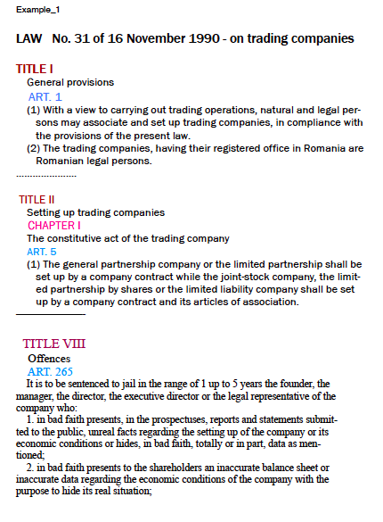
Normative act
the hypothesis
the provision or command
the sanction

Slide 13
Classifying the legal rules
According to their object:
ex. Constitutional legal rules, criminal legal rules, civil legal rules
B. According to their force: Constitution, constitutional laws, ordinary laws, Government Ordinances, Government,
emergency ordinances, government decisions
C. According to the regulated type of behavior: imperative and disposal rules
D. According to the extent of their application: general rules, special rules, exception rules
E. According to the technique used for their drawing up: perfect rules, reference rules, blank rules

Slide 14
The technical – juridical structure of a legal rule
normative acts
Laws (Statutes)
(law no. 31/1990 on commercial companies,
law no.55/2020 on measures to prevent and combat the effects of COVID )
Government Ordinances
(Emergency Ordinance no. 44/2008 - on the activity of individual merchants,
Emergency Ordinance no. 70/2020 -on measures to extend terms in tax and education )
Government decisions
(HG 394/2020 on the proclaiming state of alert and measures to apply in the period )
Ministry Orders -
elements of legal rule
paragraphs,
articles, sections,
chapters,
titles, parts or books.

Slide 15
The Romanian legal framework includes the following legal instruments:
The Constitution is the supreme law in Romania. It regulates Romania's structure as a national, single and indivisible State, the relations between the executive, the legislative and the judicial powers, and between the public bodies, citizens and legal persons.
Constitutional law emanates from the constituent power, i.e. from the constituent assembly elected and convened for this purpose.
Organic law deals with fields of major importance for the State, such as national borders, Romanian citizenship, the state coat of arms and seal, the legal arrangements for property and inheritance, and the organisation and conduct of referenda; criminal offences, sentences and rules on their enforcement, the organisation and functioning of the Superior Council of Magistracy, of the courts, of the Public Prosecution Service and of the Court of Auditors, the rights of persons harmed by a public authority, national defence, the organisation of government bodies, and political parties.
Ordinary law governs all other fields not covered by organic law. An ordinary law may not amend or modify a higher norm, such as an organic law or the Constitution.
In special cases (parliamentary recesses), certain fields, as established by Parliament, may be governed by Government orders based on the delegation of legislative powers. Orders are enacted on the basis of a special act of empowerment within its limits and under its conditions. In an emergency the Government may enact emergency orders in any field if considered necessary.
Government decisions determine how laws are to be effectively enforced or other organisational aspects regarding their application.
Legislative acts (orders and guidelines) are issued by central government solely on the basis of and in order to enforce laws, Government decisions and orders.
Acts of the autonomous administrative authorities
Legislative acts passed by local government authorities (County Council, Local Council, Bucharest Municipality General Council) govern fields falling within their competence.

Slide 16
Classification of legal rules
The imperative rules
The disposal rules
extend of their application
According to the technique
Permissive rules
General rules
Complete rules
Imposed rules
Prohibitive
rules
Suppletive rules
Special rules
Reference rules
Exception rules
Blank rules

Slide 17
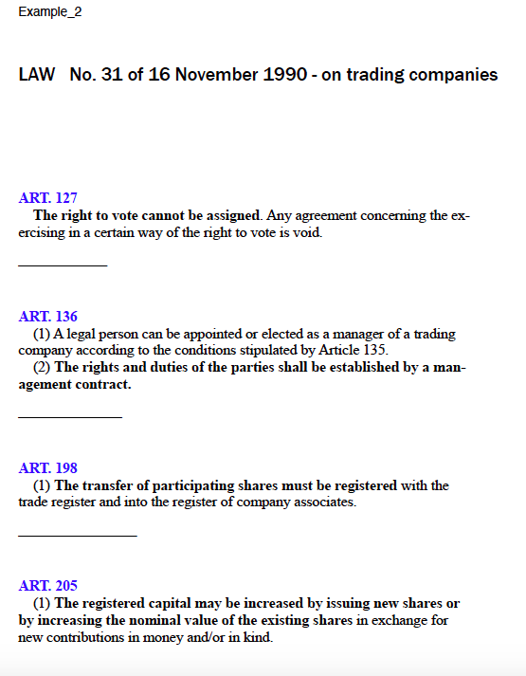
Prohibitive rule
Suppletive rule
Imperative rule
Permissive rule

Slide 18
The application of law
the application of law in space
the application of law to people
the application of law in time
law applies from the moment it enters into force until it no longer applies
the application of law in space is governed by the principle of territoriality
the beneficiaries of legal rules are natural or legal persons
people are equal in front of law

Slide 19


The application of law in TIME
1. Principle of immediate entering into force of the law:
3 days from publication or other indicated date (Art. 78 Romanian Constitution)
the provisions of the new law are applicable to all acts and facts performed after its entering into force (Art. 6 alin. 5 new Civil code )
2. Principle of non retroactivity of the law:
The law applies as it is valid. It has’n retroactivity power (Art. 6 alin.1 new Civil code)
The law applies only for the future, except ……(art 15 alin. 2 Romanian Constitution)

Slide 20
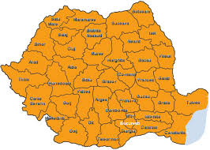
The application of law in space
The law is applicable only on the Romanian soil, except the cases when it is provided otherwise. (art. 7 new Civil code)
In case of legal relations having foreign elements, the applicable law will be determined by international legal rules. (art. 8 new civil code)

Slide 21


The application of law to people
On the territory of a state the applies to:
Nationals (citizens)
Foreigners
Stateless people
With one exception: diplomats, who are enjoying a special legal system on the territory of a foreign state.
The national law is applicable to:

Slide 22
THE INTERPRETATION OF LEGAL RULES
According to its juridical force the interpretation
official interpretation
non-official interpretation
According to the result obtained by interpretation
literal interpretation
extensive interpretation
restrictive interpretation
According to the methods used
grammatical interpretation
systematical interpretation
historical interpretation
logical interpretation

Slide 23
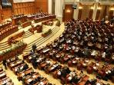

Official & Nonofficial interpretation
1. The official interpretation is given by the state institution which has this ability under law.
Actually, the Parliament, the government and the courts of law have this competence.
legal or authentic interpretation
B) judicial interpretation
2. Non-official interpretation. Who? Persons who do not act as representatives of the state.
As far as its legal force is concerned, this interpretation does not bind the judges, but may help them towards a unitary application of law.

Slide 24
Literal, extensive & Restrictive interpretation
The literal interpretation, the so-called interpretation "to the letter of law", means that the content of law and the practical issued solution are identical.
B) The extensive interpretation, the so-called interpretation "to the spirit of law", means that by comparing the content of a legal text and the practical issued solution, it appears that the legal rule covers much more cases than the legal text shows.
C) The restrictive interpretation, the so-called interpretation "to support law", means that comparing the content of the legal text to the practical issued solution, it appears that the legal text is more broadly formulated than the real intention of the legislator was.

Slide 25
The most frequently logical arguments are:
"per a contrario". This argument applies the rule of a third party's exclusion, meaning that "A cannot be A and non-A at the same time".
"a fortiori rationae". An a fortiori argument is most often adduced in order to reinforce a claim already asserted by other means.
"reductio ad absurdum". This argument is based on the fact that among the different meanings of a legal rule there should be used that one which suits better to the rule's aim.

